Slide 1
Academic and Residential Life: Challenges and Responses to COVID-19
Cynthia Barnhart, Chancellor
May 2020

Slide 2
Life at MIT, Fall 2020
Practice physical distancing (6 feet apart) inside and outside
Quarantine for 14 days upon entering state
Handwashing or sanitizing hands made available throughout campus
Increased cleaning and sanitation
Require face covering
Required testing, tracing and treatment protocols for being on campus
Some Facts
Campus academic capacity reduced (maximum of ~4000- student capacity at any time, maximum lecture room 50-70 people)
A significant percent of subjects taught on-line
Campus access will be restricted to certain students at certain times for certain locations

Slide 3
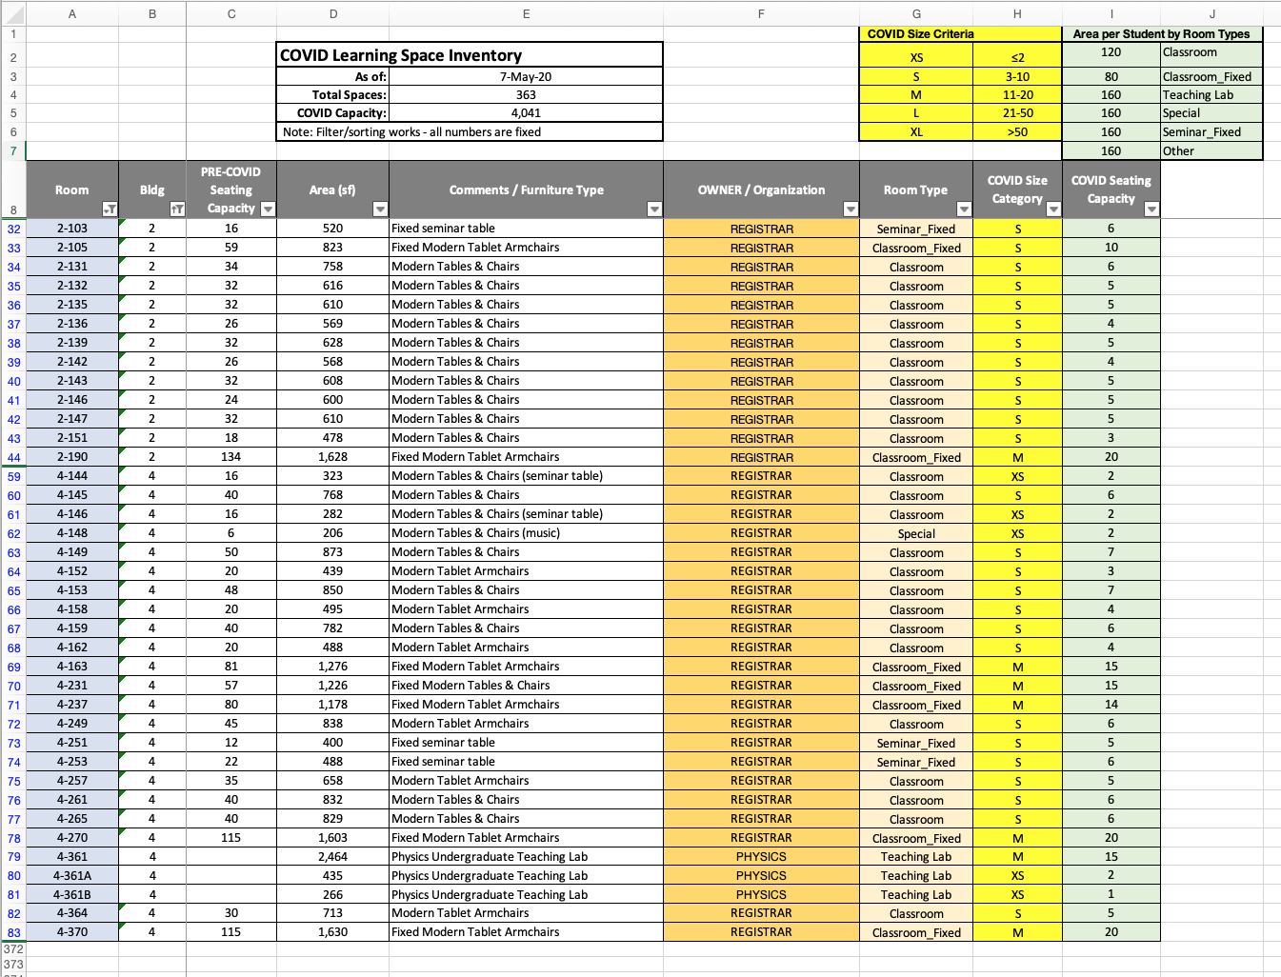
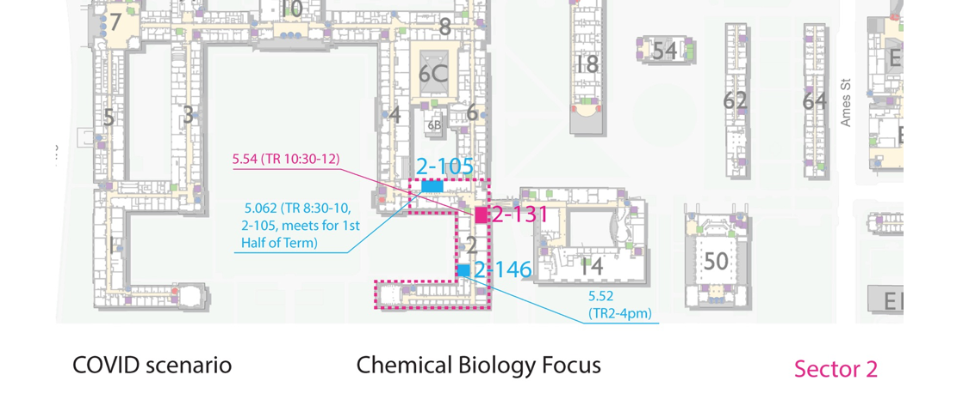
Adapting the MIT campus footprint for campus-based learning in Fall 2020
4041 learner capacity, daily max
363 learning spaces
6 learning space types
3 COVID-adjusted room sizes
1 goal: educational excellence
Relocating student classes within a single building sector each day maximizes learning while minimizing mixing (risk of community spread).
Facilitates hands-on-campus learning when lab, project, and performance key to educational outcomes.
Vikrant.S.Vaze@dartmouth.edu
Notes:
Hi Cindy,
In yesterday's email when you asked for the fall semester of 2019, I sent info for Sept-Dec 2019, which is actually academic year 2020. They're not too different but I'll put both here for your reference. Sorry for the confusion!
Sept-Dec 2019 (2020FA)
UG subjects (ignoring undergrad research/thesis): 963. G subjects (ignoring thesis): 970.
UG students taking the above subjects: 4,275. G students taking the above subjects: 4,236.
UG-subject pairs: 19,610. G-subject pairs: 15,884.
Sept-Dec 2018 (2019FA)
UG subjects (ignoring undergrad research/thesis): 904. G subjects (ignoring thesis)***: 916
UG students taking the above subjects: 4,296. G students taking the above subjects***: 3,443
UG-subject pairs: 18,947. G-subject pairs***: 13,307.
*** I only have info on the last four years of entering grad students, so there likely many missing students for 2019FA relative to 2020FA.
****
Yes, at any one time we can have 4041 learners on campus. Yes, two waves per day means we accommodate 8000 learners per day. Everything you said also follows. However, it is probably best to think of the number of unique learners per day, too, from student perspective. The more waves you add then the more you are likely to serve the same learner multiple times in one day (so you are estimating too high because you’re not accounting for that double counting. In two waves per day, it is reasonable that all my on-campus learning is met in my half-day stint on campus. If five waves, I probably have to come back for more than one of those waves per day to get my on-campus class hour needs met.
The 4000 learners at one time is based only on the “classroom capacity” and is divorced from considerations of the rest of the campus staff who would be there to support it. Our reasoning was that the central mission is education of students, so we’d adapt the community capacity accordingly. However, we can run those numbers. The basic calculus you can keep in mind is that there are 50% students and 50% others on the MIT campus in normal times. If we kept that 1:1 ratio of student to other, which is not default but does seem possible with many non-essential staff WFH (e.g., admin assistants) or not-at-work (e.g., events staff, dining staff), then 4000 learners would mean 8000 people on campus at a time. That would mean the campus is ~40% full, compared to the normal 20K MIT ID card holders per day.
Still working on that and will get it before noon today. To get the COVID capacity, we used rooms that we do not normally schedule for classes (e.g., Samberg) or that are not Registrar-managed, so I have to do a bit of deconvolution.
The best estimate I have for you so far is that the MIT pre-COVID capacity is between 12,250 to 13,450 learners. So let’s say 13,000 learners.
To refine, we need to gather capacity in DLC-managed classrooms, like a MechE Teaching Lab that never needed to write that down before. We know the room size but not the normal-time number of students those instructors thought fit in that teaching lab. Right now, those entries are “blank” and we just used their room size (total square feet) to estimate the COVID capacity.
Here, I assumed 100 sf/student in all the DLC-managed teaching spaces as crude estimate of how many learners fit in all those room types. It is a fair guess, because many of these rooms have a lot of equipment or fixed tables in them.
Also, as we think our way forward, the DLC-managed classrooms are a luxury that we may need to relax in the coming academic year. For example, Sloan has learning spaces for Exec Ed and other degree programs; they are not accessible to SHASS for classes. To use all the available learning spaces, it will help to consider all the learning spaces as MIT spaces, not balkanized as Registrar spaces and DLC spaces.

Slide 4
Life at MIT, Fall 2020
Practice physical distancing (6 feet apart) inside and outside
Quarantine for 14 days upon entering state
Handwashing or sanitizing hands made available throughout campus
Increased cleaning and sanitation
Require face covering
Required testing, tracing and treatment protocols for being on campus
Some Facts
Campus academic capacity reduced (maximum of ~4000- student capacity at any time, maximum lecture room 50-70 people)
A significant percent of subjects taught on-line
Campus access will be restricted to certain students at certain times for certain locations
Reduced graduate and undergraduate residence hall capacities
Maximum capacity of residences and FSILGs in fall at about 50% of the UG student population
Will increase when construction of new residence halls complete, expected end of year 2020
85% of graduate student housing capacity available

Slide 5
2020 Fall Residential Capacity
~4500 registered undergraduates per semester
Shortage of ~1800 beds in the fall
Ways to close the ~1800-bed gap
Rent hotels or apartments
Potential for 1000 beds in nearby and local hotels
4500: number of UGs registered; 4100 typically in MIT-affiliated housing
Relax or transform density rules (pods, fixtures, etc.)
Reduces isolation, disease spread implications
4100
Gap: up to
~1800 beds
Fall 2020
Suspend on-campus housing guarantee for upper-level students
Responsibility to greater Boston community?
3000
2300
2-Semester Model: Limit students to one semester on-campus and one-semester remote (no access to campus)
~2300: MIT housing
capacity in fall 2020
Beds
Available
3-Semester Model: Spread two semesters of subject offerings over three semesters
Increases residential and academic capacity by 50%
Maintains on-campus access for two semesters for each student

Slide 6
2020 Fall Residential Capacity
2020 Fall Residential Capacity
3-Semester Model (S1, S2, S3)
~2250 registered UGs in S1
[25% UGs registered in Semester 1 (S1) and Semester (S2); 25% UGs registered in S1 and Semester 3 (S3); 50% UGs registered in S2 and S3]
Bed shortage = 0
4100: typical MIT-affiliated housing capacity
Matching the number of registered students on campus with the number of available beds in MIT housing
~50% of students in semester 1 (S1)
Adjust the number of students registered in winter and spring semesters to reflect changes to available capacity
Likely scenario: 75% of undergraduates registered in Semester 2 (S2) and in semester 3 (S3)
New residence halls on-line by end of December 2020
Relaxed social-distancing protocols for students with known immunity
Optimistic scenario: 100% of undergraduates registered in Semester 2 (S2) and 50% in Semester 3 (S3)
Availability of treatments (therapeutics, vaccines)
4100
3000
~2250
(to 4500): number of registered UGs semesters 2, 3
~3000 ( to 4100): MIT housing
capacity end of December 2020
2300
~2300: MIT housing capacity start of fall 2020
Beds
Available
~2250: number of registered UGs semester 1

Slide 7
The 3-Semester Model: Optimizing the Educational and Residential Experience
3-Semester Model:
Decide for each subject offering, which one semester it will be offered
Decide for each student, which two semesters the student is on-campus (and which one semester the student is remote)
Fall Semester subjects
Spring Semester subjects
Semester 1 subjects + 50% of UGs on-campus
Semester 2 subjects + 75% of UGs on-campus
Semester 3 subjects + 75% of UGs on-campus
INDIVIDUALS
MAJOR-CLASS YEAR
(e.g, 2nd-year 6-3s)
All registered undergraduate students: Assign to 2 semesters on-campus
Some possible implementations :
INDIVIDUALS:
Decide which subset of individual students is on-campus together (and which is remote)
MAJOR-CLASS YEAR:
Decide which grouping of students by program-year (e.g., third-year 6-3 (primary) majors) is on-campus together (and which is remote). All first-years are a program-year cohort.
CLASS YEAR:
Decide which grouping of students by class year (1st-, 2nd-, 3rd-, and 4th-years), and which is remote.
CLASS YEAR
(1st, 2nd, 3rd, 4th-years)
For the purposes of illustration, we considered the following class-year combination:
1st-years on-campus semesters 1 and 3 (remote semester 2)
2nd-years on-campus semesters 1 and 2 (remote semester 3)
3rd-years on-campus in semesters 2 and 3 (remote semester 1)
4th-years on-campus in semesters 2 and 3 (remote semester 1)
Notes:
For All 3-semester variants: decide how to spread over three semesters all subjects offered in 2 semesters by offering subjects taught in the fall in either the fall or winter semester, and all subjects taught in the spring in either the winter or spring semester. The maximum number of students assigned in any semester cannot exceed residential capacity— 50% in the fall; and 75+% in the winter and spring semesters due to new residence halls coming on-line, some students having immunity, and possible treatments being introduced. The objective is to maximize students' presence on-campus during the semesters when subjects required for their major or requiring on-campus presence are offered. (Note, we defined subjects required by a major as all those for which at least 10% of students in the major take the subject.)
For 3-flexible variant: jointly decide 1) in which semester each subject is offered; and 2) for each student, which two semesters the students are on-campus (and which they are remote)
For 3-Major-year partition: jointly decide 1) in which semester each subject is offered; and 2) for each program (major), which two semesters a program is assigned such that the number of associated students (primary majors) does not exceed residential capacity in any semester. Each student is on-campus the two semesters assigned to that student’s primary major, and remote in the other semester. NOTE: first-year students are considered one cohort— all with the same ‘1st-year’ major.
For 3-FA1-2/ WI 2-3-4 / SP 1-3-4: decide only when subjects are offered, given 1st-years are on-campus in the fall and spring (and remote in the winter), 2nd-years are on-campus in the fall and winter and remote in the spring, 3rd-years are on-campus in the winter and spring and remote in the fall, and 4th-years are on-campus in the winter and spring and remote in the fall. (Note: all other combinations of class years are possible. This is just an illustrative example.)

Slide 8
Optimization Results
Data 2020FA and 2020SP
4,278 students
588 subjects in 720 offerings
5.2 required subjects per student (“common major subjects” + GIRs + lab/design/project/performance subjects)
Results
Number of subjects taught in fall (with smaller differences for other semesters)
369 taught in 2-semester fall
124-213 taught in the 3-semester fall
Percent of subjects— commonly taken in a major or requiring on-campus presence— that are taught when the student is on-campus
51-59% for 2-semester model
92-96% for 3-semester model
Number of subjects that have the potential for components (or all of the subject) to be taught fully in-person
108-168 in the 2-semester model
501-518 in the 3-semester model
Number of Semesters | Student Assignment Approach | ‘Required’ Subjects Taught while Student is On-Campus | Number of Subjects Taught FA/S1 | Offerings with > 95+% Enrollment on Campus (out of 720 offerings)
2 | Individuals | 59% | 369 | 108 offerings
2 | Major-class year FA 1-2 / SP 3-4 | 57% | 369 | 168 offerings
2 | Class Year | 51% | 369 | 163 offerings
3 | Individuals | 96% | 191 | 501 offerings
3 | Major-class year | 96% | 213 | 518 offerings
3 | Class year S1 1-2 / S2 2-3-4 / S3 1-3-4 | 92% | 124 | 511 offerings
Significant contributions in generating optimization results thanks to: Dr. Julia Yan and PhD student Arthur Delarue, and Professor Dimitris Bertsimas (Operations Research Center, MIT)
Notes:
Unsatisfied subjects are mostly due to prereqs that students often skip anyway.
Our model takes prerequisites more seriously than students actually do because we wanted to make sure that the schedule did not force students to skip prerequisites just because prior year students had done so. So, if a student cannot take a subject without fulfilling the prerequisites earlier, we count it as unsatisfied, even if in real life the student had skipped the prerequisite. FA subjects are especially impacted because prerequisites cannot be slotted beforehand; this is alleviated in the 3-term solution because FA subjects can be moved to WI if they have a FA prerequisite.
Note that the additional prerequisites we add to student subject lists do not count for the cap of number of courses taken per semester unless the student actually was interested in taking that prerequisite.
Examples of commonly unsatisfied subjects:
6.006 Intro Algorithms (usually FA, moved to WI in 3-term solution)
6.042 Math CS (usually FA/SP) is a prerequisite that would need to be taken the previous year. Many students actually skip this prerequisite. The 3-term solution moves 6.006 to WI so that students can possibly take the prerequisite in FA.
18.022 Calculus II (FA)
Calculus I is a prerequisite that many students skip.
18.701 Algebra I (usually FA, sometimes moved to WI in 3-term solution)
Real Analysis is a prerequisite that many students skip. The 3-term solution sometimes moves 18.701 to WI so that students can possibly take the prerequisite in FA.
Largely Course 6 subjects where prereqs are only loosely adhered to.
The updates we made:
We added the list of lab/design/performance classes from Mary Callahan. 145/217 of those subjects appear in the undergrad data; the remainder are graduate courses. Note that this increases the subjects per student from 4.7 to 5.2 (and so the model performance declines slightly across the board).
We added the metrics discussed today on subjects that have >95% of students on campus.
We checked the subjects per student in some detail. On average, first years have 6.5 subjects per student, and this number declines year-by-year until seniors have 3.3 subjects per student. Seniors were more likely to take on lighter courseloads or to take more “fun” subjects (e.g. Russian) which we end up dropping.
We are also attaching the spreadsheets of the schedule and the metrics broken down by major for the most flexible 3-semester option. We can easily generate these for the other options if needed.
Data. 2020FA and 2020SP
4,278 students
588 subjects in 720 offerings
5.2 required subjects per student (“common major subjects” + GIRs + Mary Callahan’s lab/design/performance subjects)

Slide 9
Scheduling Opportunities
2-Semester Model
3-Semester Model
Begin fall semester start of September and end instruction before Thanksgiving
Eliminate need for travel at Thanksgiving and end of Semester
Safeguards ‘second-wave’
Begin classes 1-week early
Reduce the length of the semester by 1-week to end instruction before Thanksgiving
Move final exams on-line, beginning the week after Thanksgiving
Start fall semester as late as January
If known by late summer that a vaccine will be available by end of fall
Elimination of IAP
Compress 3-semesters to begin start of Sept and end third week in June
Reduce the length of each semester by 1-week
End S1 instruction before Thanksgiving
Start S2 with 2-weeks of on-line instruction in December
Eliminates need for students to travel in December
Eliminate IAP
2-week break for December holidays, 1-week break at end of March
Notes:
Thinking about Asu’s idea— she wants to require each student who needs to take a subject with required campus presence (RCP) to be part of the 50% on-campus cohort and she wants to incentivize the remaining students (at least 50% of the total student population) to choose to be remote students (R). If that happens, would an entry in Table 2 for this scenario look any different than the current entries? In others words, if 50% of the students have RCP in any semester (and it is likely that RCP would be defined to have required presence of 1/2 of the students in one semester and the other half in the other semester— for equity reasons). So no different,
academic excellent (degree of in-person education);
safety and well-being of the community (on-campus population, hotels, academic calendar schedule, etc.);
access/ equity (who gets to live in MIT housing and who get access to in-person on-campus education);
etc.
https://registrar.mit.edu/calendar/class-days
Academic Year 2020-2021
FALL TERM The fall term runs from Wednesday, September 9 through Thursday, December 10 for a total of 63 class days:
12 Mondays, 13 Tuesdays, 13 Wednesdays, 13 Thursdays, 12 Fridays
SPRING TERM The spring term runs from Monday, February 1 through Tuesday, May 11, for a total of 65 class days:
13 Mondays, 13 Tuesdays, 13 Wednesdays, 13 Thursdays, 13 Fridays
SUMMER SESSION The summer session runs from Monday, June 7 through Tuesday, August 11 including the exam period.
https://www.bbc.com/news/health-51665497 About 80 groups around the world are researching vaccines and some are now entering clinical trials.
Most experts think a vaccine is likely to become available by mid-2021, about 12-18 months after the new virus, known officially as Sars-CoV-2, first emerged.
That would be a huge scientific feat and there are no guarantees it will work.
Four coronaviruses already circulate in human beings. They cause common cold symptoms and we don't have vaccines for any of them.
It will, almost inevitably, be less successful in older people, because aged immune systems do not respond as well to immunisation. We see this with the annual flu jab.
https://www.weforum.org/agenda/2020/05/what-you-need-to-know-about-the-covid-19-vaccine/
Bill Gates on May 4, World Economic Forum Predictions show it could take anywhere from 9 months to 2 years to create a vaccine.
From there, it's just the small matter of producing upwards of 7 billion doses, for the global population.
https://www.acha.org/documents/resources/guidelines/ACHA_Considerations_for_Reopening_IHEs_in_the_COVID-19_Era_May2020.pdf
Until a vaccine for COVID-19 is available and widely used or until an effective prophylactic treatment is discovered, physical distancing, viral testing, isolation, quarantine, and contact tracing are our best strategies to control the spread of this virus.

Slide 10
2-Semester Model vs. 3-Semester Model
2-Semester Model
3-Semester Model
For an undergraduate student registered for 2-semesters
1-semester on-campus, 1-semester remote
Unless hotel capacity purchased
Almost all subjects taught on-line
‘Tried and true’ academic schedule
For an undergraduate student registered for 2-semesters
2-semesters on-campus, 1-semester remote
Maximizes number of labs, design, project, performance, small-group discussion subjects or components of subjects to be offered in-person
‘Bonus’ semester allows speed-up to degree completion
Added schedule complexity and extended academic year calendar, may require additional support for instruction and administrative staff roles.
Impacts
Safety
Quality of educational and social experience
Mental health and wellbeing
Numbers of students deferring or taking leaves
Pricing
Notes:
Spreading 2 semesters over 3 increases housing and academic capacities by 50%
All registered students have 2 semesters on-campus
On-time progress to degree completion without remote semester
Bonus (optional) remote semester allows students to speed-up degree completion
100% of registered students can reside in MIT housing
By jointly optimizing decisions of when a subject is offered and which students are on campus:
Students required to take a subject for on-time degree completion are on campus when the subject is offered
Provides maximum opportunity for in-person learning
Minimizes the number of subjects that must be offered on-line learning for degree progression
Thinking about Asu’s idea— she wants to require each student who needs to take a subject with required campus presence (RCP) to be part of the 50% on-campus cohort and she wants to incentivize the remaining students (at least 50% of the total student population) to choose to be remote students (R). If that happens, would an entry in Table 2 for this scenario look any different than the current entries? In others words, if 50% of the students have RCP in any semester (and it is likely that RCP would be defined to have required presence of 1/2 of the students in one semester and the other half in the other semester— for equity reasons). So no different,
academic excellent (degree of in-person education);
safety and well-being of the community (on-campus population, hotels, academic calendar schedule, etc.);
access/ equity (who gets to live in MIT housing and who get access to in-person on-campus education);
etc.
https://registrar.mit.edu/calendar/class-days
Academic Year 2020-2021
FALL TERM The fall term runs from Wednesday, September 9 through Thursday, December 10 for a total of 63 class days:
12 Mondays, 13 Tuesdays, 13 Wednesdays, 13 Thursdays, 12 Fridays
SPRING TERM The spring term runs from Monday, February 1 through Tuesday, May 11, for a total of 65 class days:
13 Mondays, 13 Tuesdays, 13 Wednesdays, 13 Thursdays, 13 Fridays
SUMMER SESSION The summer session runs from Monday, June 7 through Tuesday, August 11 including the exam period.
https://www.bbc.com/news/health-51665497 About 80 groups around the world are researching vaccines and some are now entering clinical trials.
Most experts think a vaccine is likely to become available by mid-2021, about 12-18 months after the new virus, known officially as Sars-CoV-2, first emerged.
That would be a huge scientific feat and there are no guarantees it will work.
Four coronaviruses already circulate in human beings. They cause common cold symptoms and we don't have vaccines for any of them.
It will, almost inevitably, be less successful in older people, because aged immune systems do not respond as well to immunisation. We see this with the annual flu jab.
https://www.weforum.org/agenda/2020/05/what-you-need-to-know-about-the-covid-19-vaccine/
Bill Gates on May 4, World Economic Forum Predictions show it could take anywhere from 9 months to 2 years to create a vaccine.
From there, it's just the small matter of producing upwards of 7 billion doses, for the global population.
https://www.acha.org/documents/resources/guidelines/ACHA_Considerations_for_Reopening_IHEs_in_the_COVID-19_Era_May2020.pdf
Until a vaccine for COVID-19 is available and widely used or until an effective prophylactic treatment is discovered, physical distancing, viral testing, isolation, quarantine, and contact tracing are our best strategies to control the spread of this virus.

